Slide 1
Analysis of Electricity Dispatch

Slide 2
Introduction
The process of continuously generating the electricity output from power plant to meet the electricity demand is called as electricity dispatch.
Mainly hydroelectric power plants and diesel-fired power plants are included here.
Let’s look forward for the analysis of hourly electricity dispatch of all the power plants in month July.

Slide 3
Data Preprocessing
Actual dispatch values were stored in separate sheets in a single excel file.
Forecasted dispatch values were stored separate excel files.
So, both actual and forecasted values were taken into one csv file and took the difference between actual and forecasted values.
Let’s have a look at the final dataset.

Slide 4
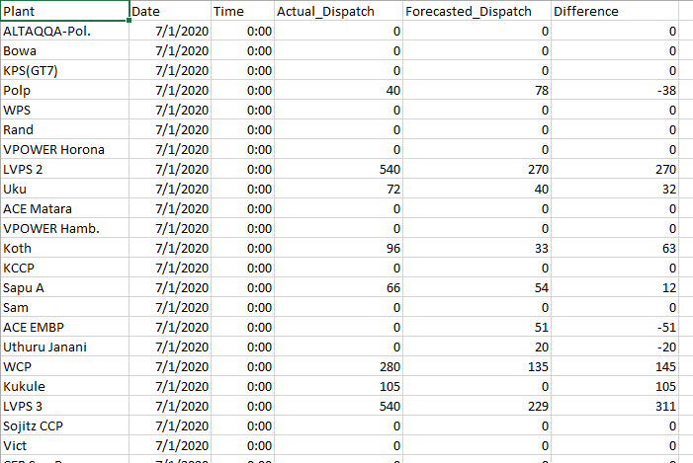

Slide 5
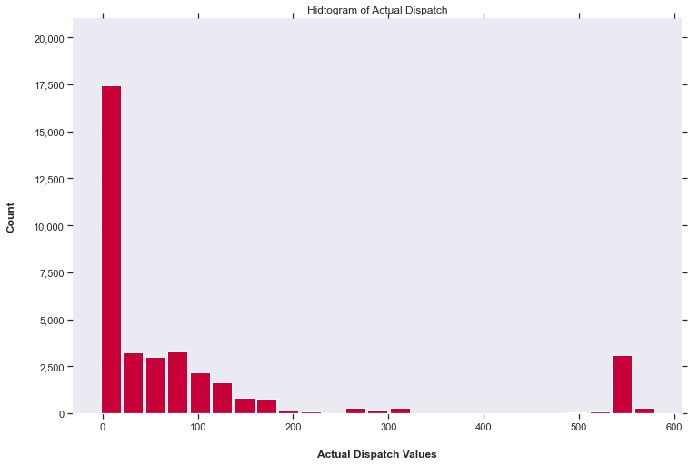
Distribution of Actual Dispatch-Month of July
Most of the Actual Dispatches are between 0-200

Slide 6
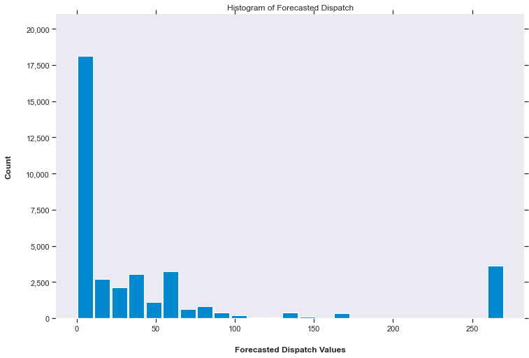
Distribution of Forecasted Dispatch-Month of July
Most of the Forecasted Dispatches are between 0-50

Slide 7
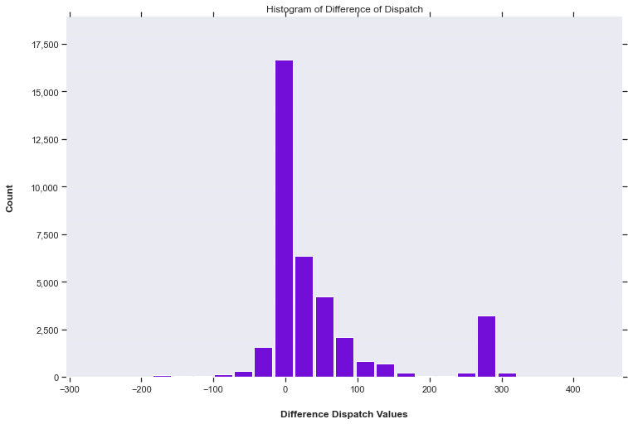
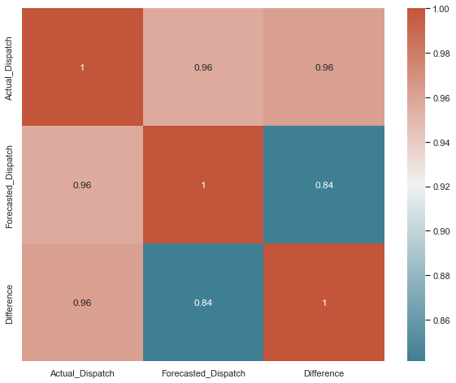
Distribution of Difference of Dispatch-Month of July
Correlated

Slide 8
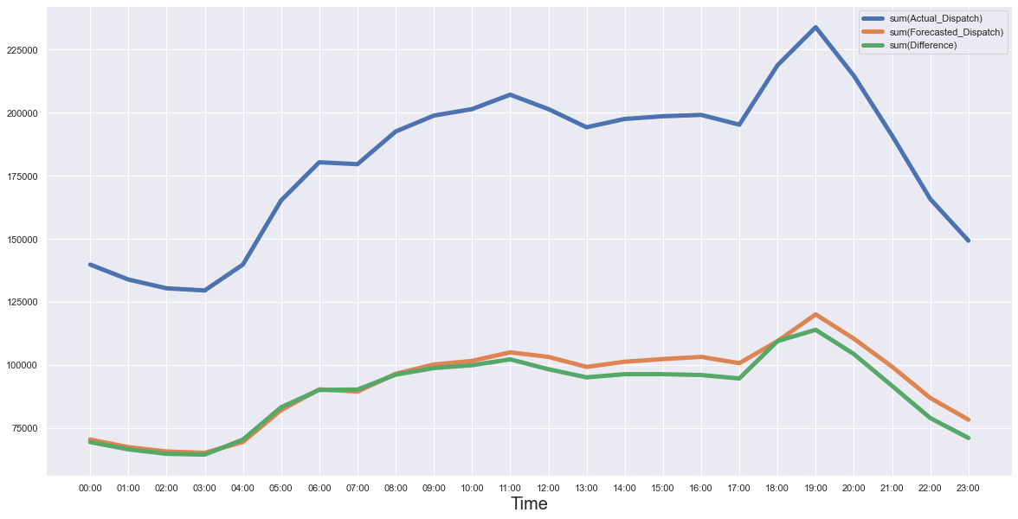
Hourly Dispatch Variation
Peak Hours
18:00-20:00
Off-Peak Hours
01:00-03:00

Slide 9
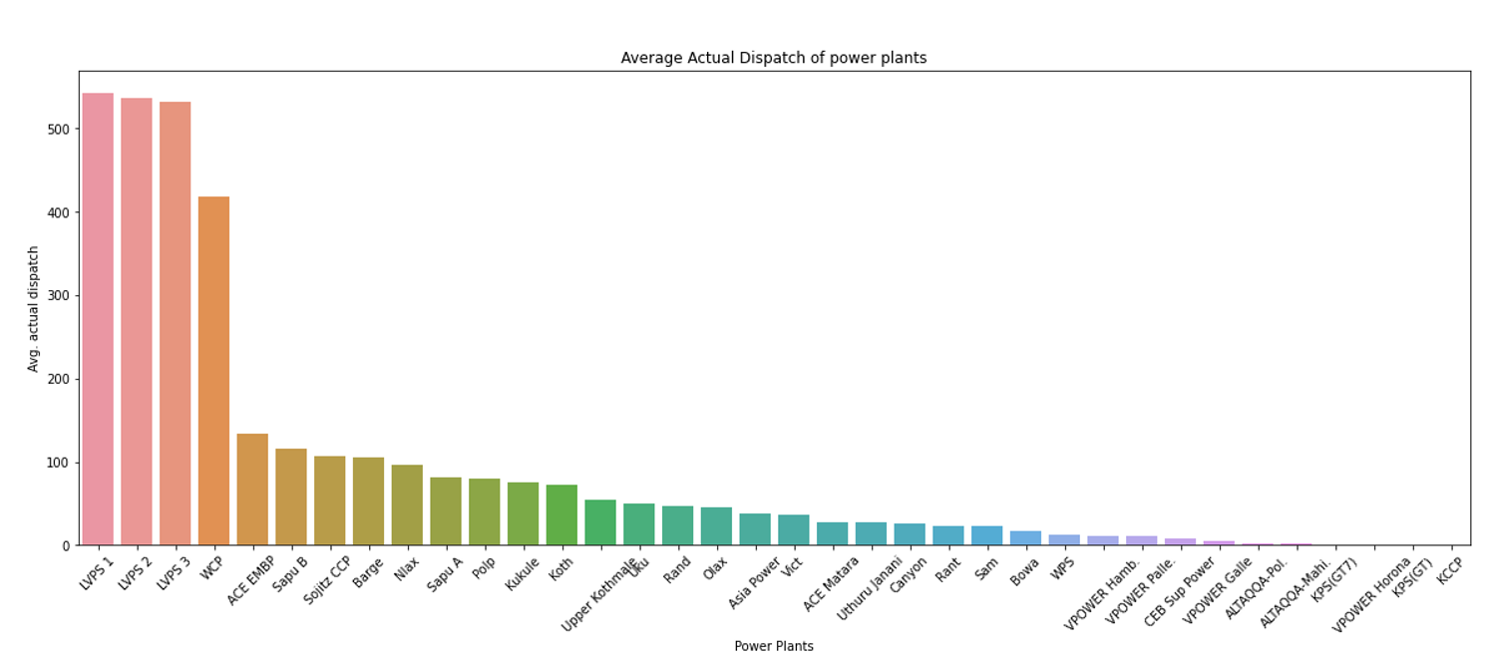
Plant-wise Variation
LVPS 1, LVPS 2,LVPS 3 Plants have the Highest Actual Dispatch

Slide 10
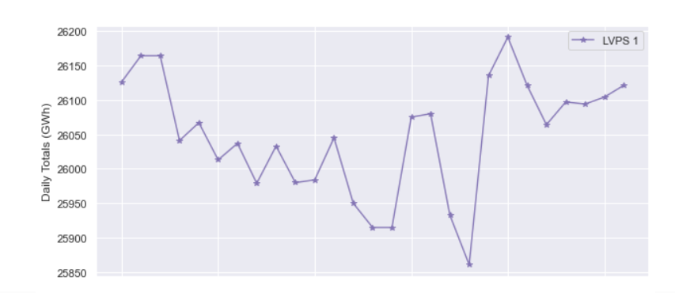
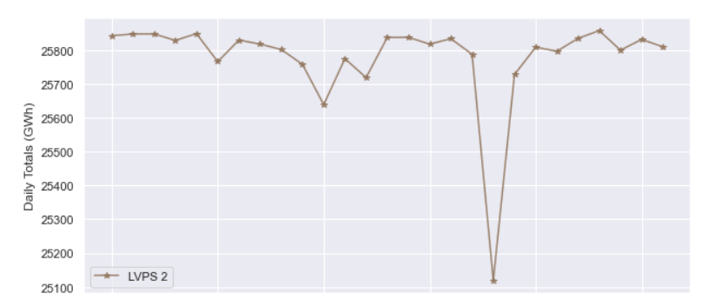
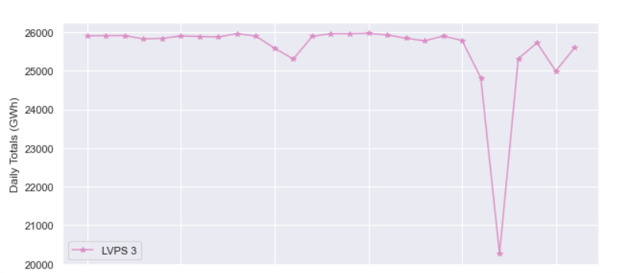
Mostly generated Plants-Daily Actual Dispatch
LVPS 1
LVPS 2
LVPS 3

Slide 11
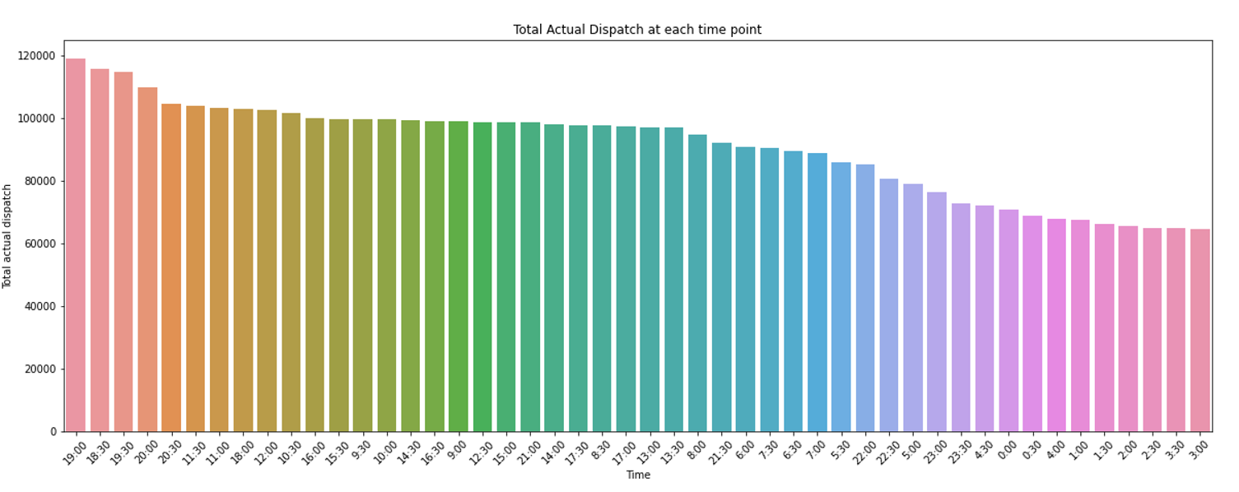
Time-wise Variation
Peak Hours
Off -Peak Hours

Slide 12
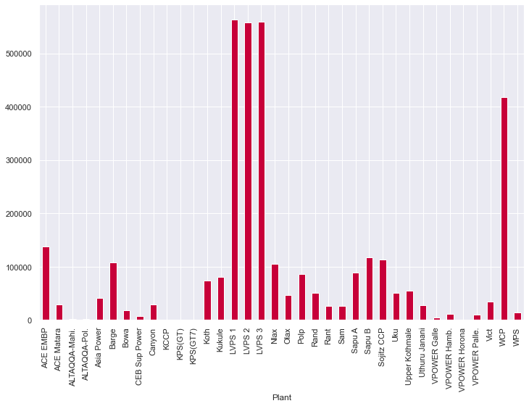
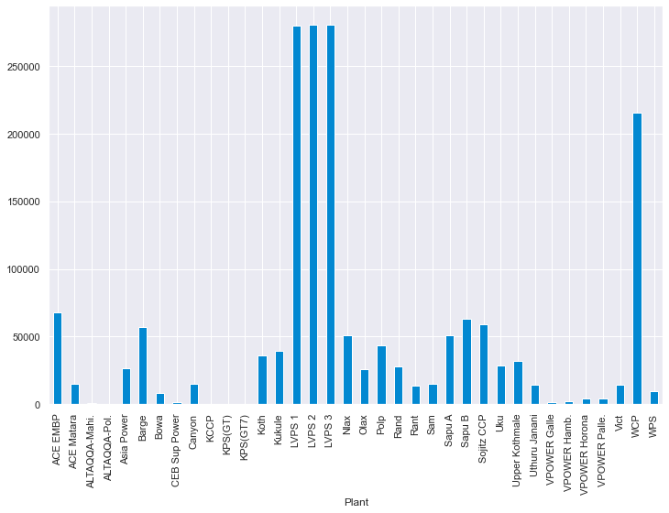
Comparing the Actual and Forecasted Dispatch Values
Actual Dispatch
Forecasted Dispatch
Not operated
Not operated even forecasted

Slide 13
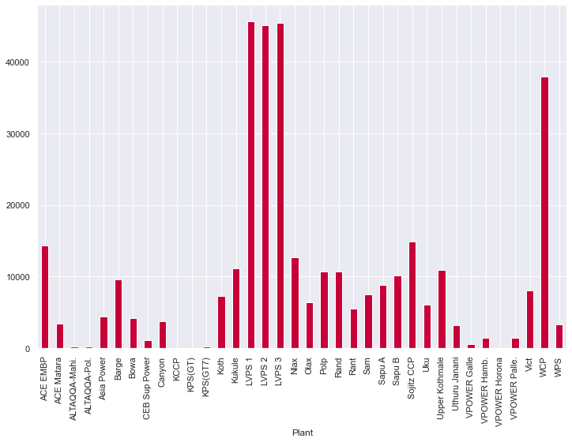
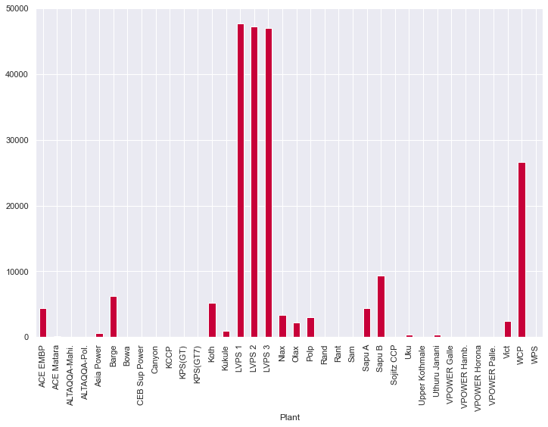
Plant-wise Variation-Actual Dispatch
Peak Hours
Off- Peak Hours

Slide 14
Plant-wise Variation-Actual Dispatch
Peak Hours
Off- Peak Hours
Most of the Plants are not operated in off Peak Hours

Slide 15
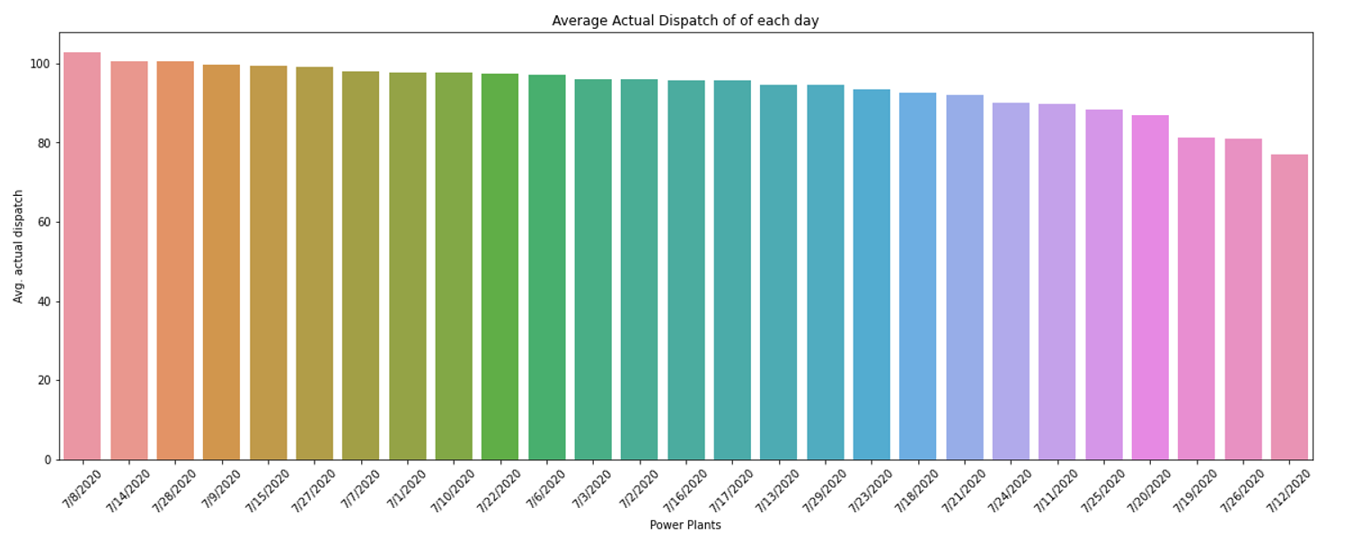
Date-wise Variation

Slide 16
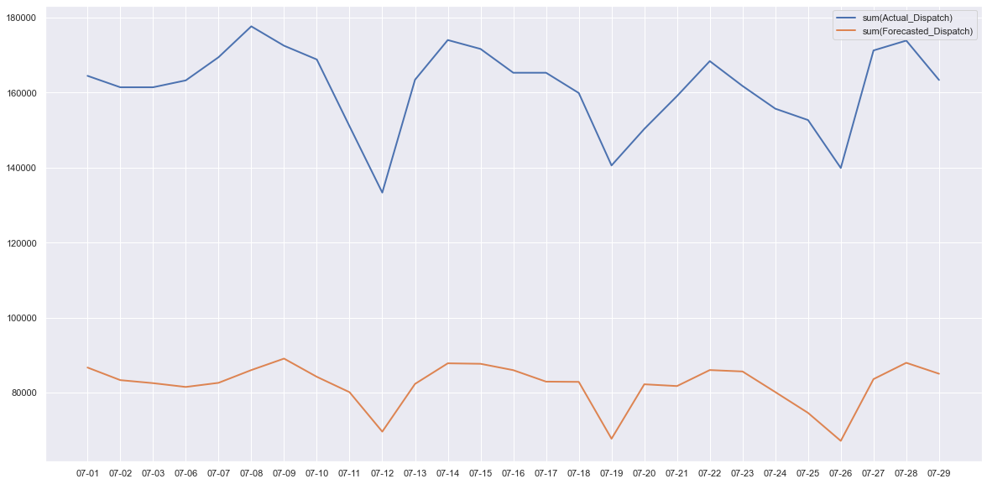
Daily Dispatch Variation-Month of July
Minimum Actual Dispatch 12-July
Maximum Actual Dispatch
08-July

Slide 17
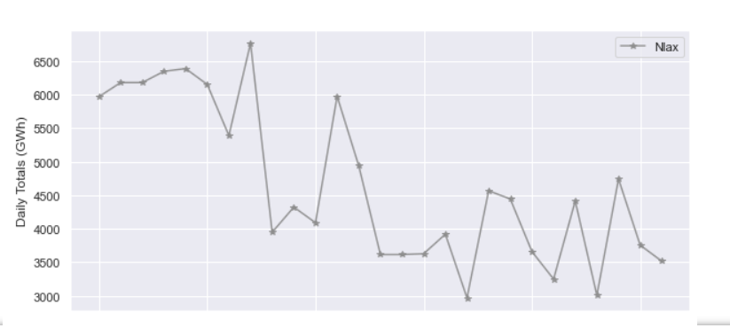
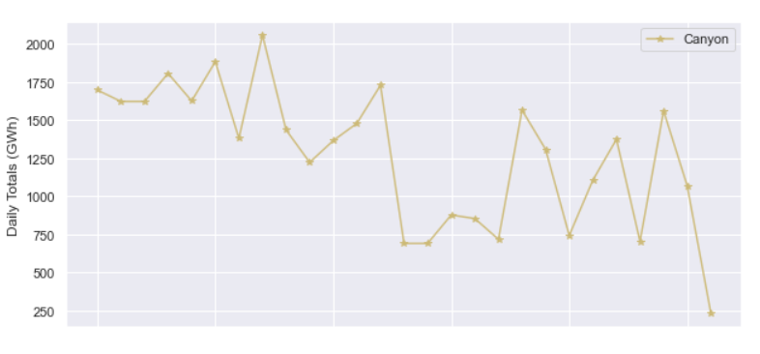
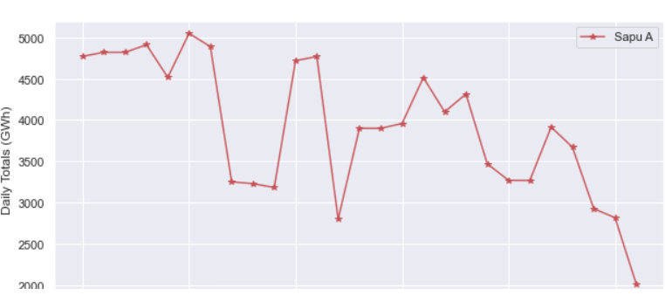
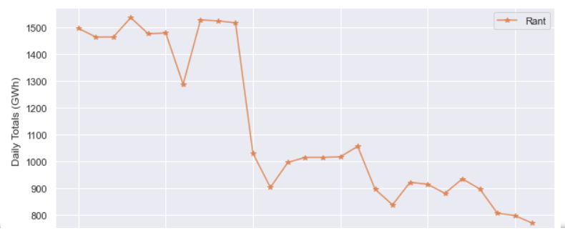
Plant-wise Variation-Daily Actual Dispatch

Slide 18
Plant-wise Variation-Daily Actual Dispatch
Downward Trends
NLAX
CANYON
SAPU A
RANT

Slide 19
Final Findings
Actual Dispatch , Forecasted Dispatch, Difference are highly correlated.
Most of the plants have generated dispatches more than forecasted.
Plants; LVPS 1, LVPS 2, LVPS 3 & WCP are having the highest total number of dispatches during the month.
ATAQQA-Mahi, ATAQQA-Pol, KCCP,KPS(G17), KPS(GT17), VPOWER-Palle plants are not operated in month of july.

Slide 20
Final Findings
Lowest no of dispatches are generated in 1.00 AM to 3.30 AM (off peak times) as in this time electricity consumption is minimum.
Higher no of total dispatches has been generated during 6.30 pm to 8.30pm (peak hours) as these are the peak times of using electricity.
Most of the plants are operated during peak times while less no of plants are operated during off-peak hours. Plants LVPS 1,2,3 and WPS have covered the required no of dispatches in both peak and off peak times.

Slide 21
Thank You !!!

